Slide 1
Virtual Stock Trader
Sponsors: Titi, Sandil, Gormley, Joe Corr

Slide 2


Our Agenda
Teach new investors about how the stock market can be used?
Make sure that investors know what they are doing?
Give new investors the chance to learn how the stock market works?
Teach new stock market investor #1

Slide 3
The Elevator Pitch
For [new investors]
who [need a safe way of exploring the functions of the stock market]
the [Virtual Stock Trader]
is [a mobile phone application]
that [allows inexperienced users to learn the basics of the stock market without risks to their finances].
Unlike [ETORO and similar companies]
our product [allows users to simulate stocks without risking their hard-earned money in the process].

Slide 4
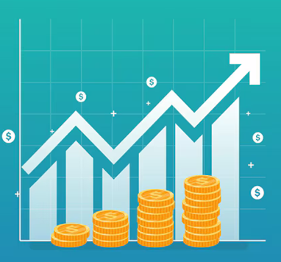
Product Box
Virtual Stock Trader
Trade Safe and Easy
Instant access straight from your phone
Virtual stocks, no risk involved
Training ground for new investors

Slide 5
The Not List​
In | Out
Live stock tracking | Random Tips
Specific stock search | View others’ trades
Purchase fake currency | Trading Leaderboard
Unresolved
Verifying & signing in through user email
View your statistics & graphs of your trading history

Slide 6






Our Project Community
Trading Newcomers
The Stock Market
Our Development Team
Publicly Traded Companies
Day Traders

Slide 7
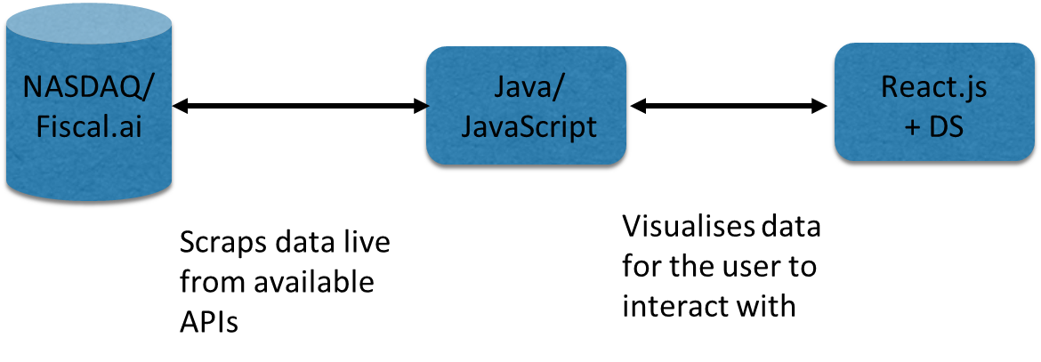
Technical Solution
Technologies:
Frontend:
React.js + DS
Java/JavaScript API Implementation
Backend:
Fiscal.ai
NASDAQ (libraries/live info)

Slide 8
What Keeps us up at night?
Data Collection
Finding free and available APIs
Cost
Paying for APIs if free ones aren’t available
Inaccurately predicting trades
Giving a false idea of how the market works

Slide 9



The A Team
Development Team
Team Lead
DevOps
Notes:
Development Team made up of a tester, product owner and scrum master; familiar with data scrapping, data visualisation, jQuery, Java/JavaScript

Slide 10

How Big is this thing?​
Development
Approx. 10 – 12 weeks
Testing
Approx. 2 – 3 weeks
Release
Approx. 2 weeks

Slide 11
First Release
Stability
Users have learnt and are comfortable
Bumps & Issues
Users adjusting to the app
Release
Excitement, users learning

Slide 12
THANK YOU!
Lemon Oligarchy

